Slide 1


Metallic Bonding

Slide 2
Learning Objective
To understand how a metallic bond is formed.
Success Criteria
To identify and list properties of metals.
To describe the bonding in metallic structures.
To explain the properties of metallic structures.

Slide 3

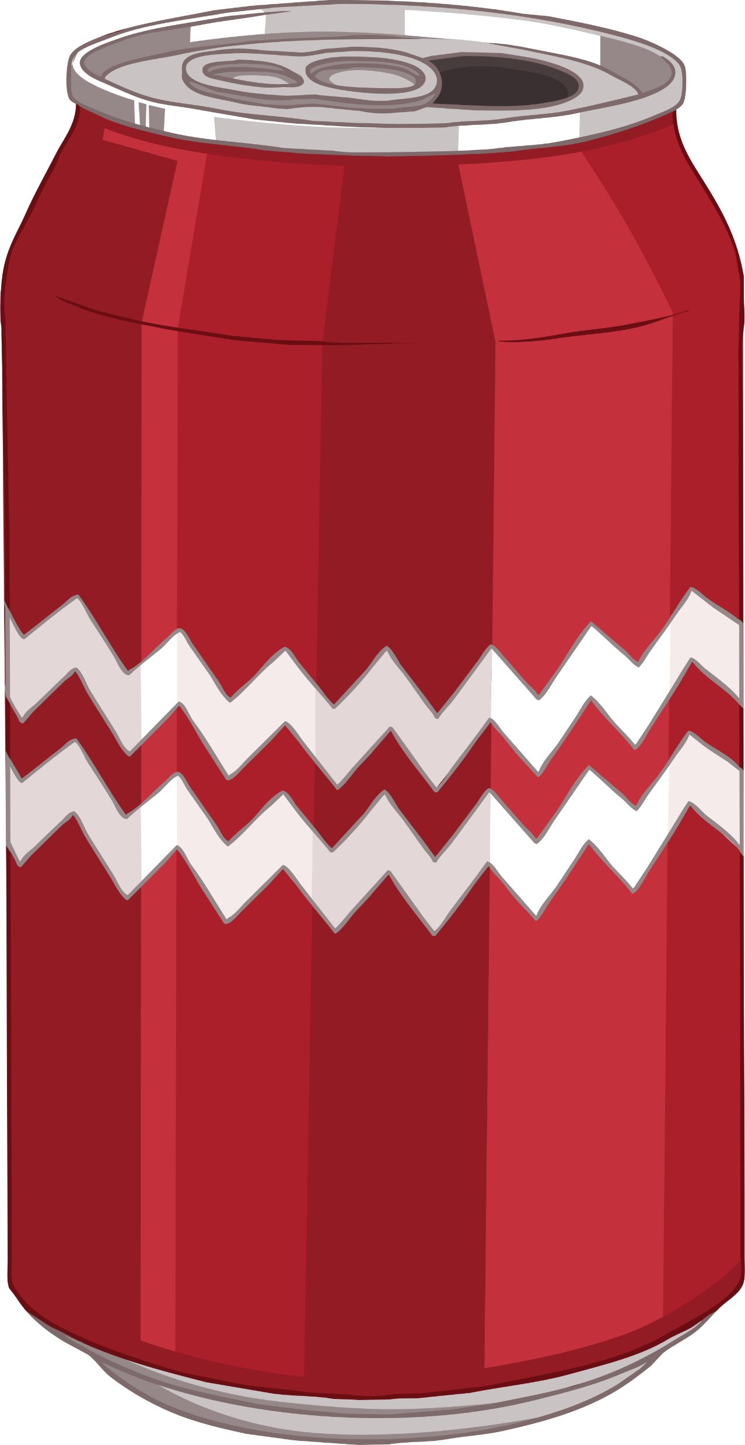

A to Z of Metals
In pairs, can you think of a metal for each of the letters of the alphabet?
Next to each metal, write (E) if you think it is a pure metal
element or (A) if you think it is a mixture of metals.
For example: A = aluminium.

Slide 4
A to Z of Metals
aluminium | francium | k (x) | platinum | uranium
bronze (A) | gold | lead | q (x) | vanadium
copper | hafnium | mercury | radium | yttrium
dysprosium | iron | nickel | steel (A) | zinc
einsteinium | j (x) | osmium | titanium
Did you think of any different ones?

Slide 5
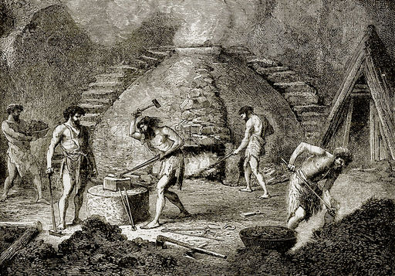
Alloys
Did you notice two of those metals had a letter (A) next to them?
A mixture of two or more metals is called an alloy.
Bronze was the first alloy to be discovered, from a period of time now known as the Bronze Age.
Photo courtesy of Kim Støvring (@flickr.com) - granted under creative commons licence - attribution

Slide 6
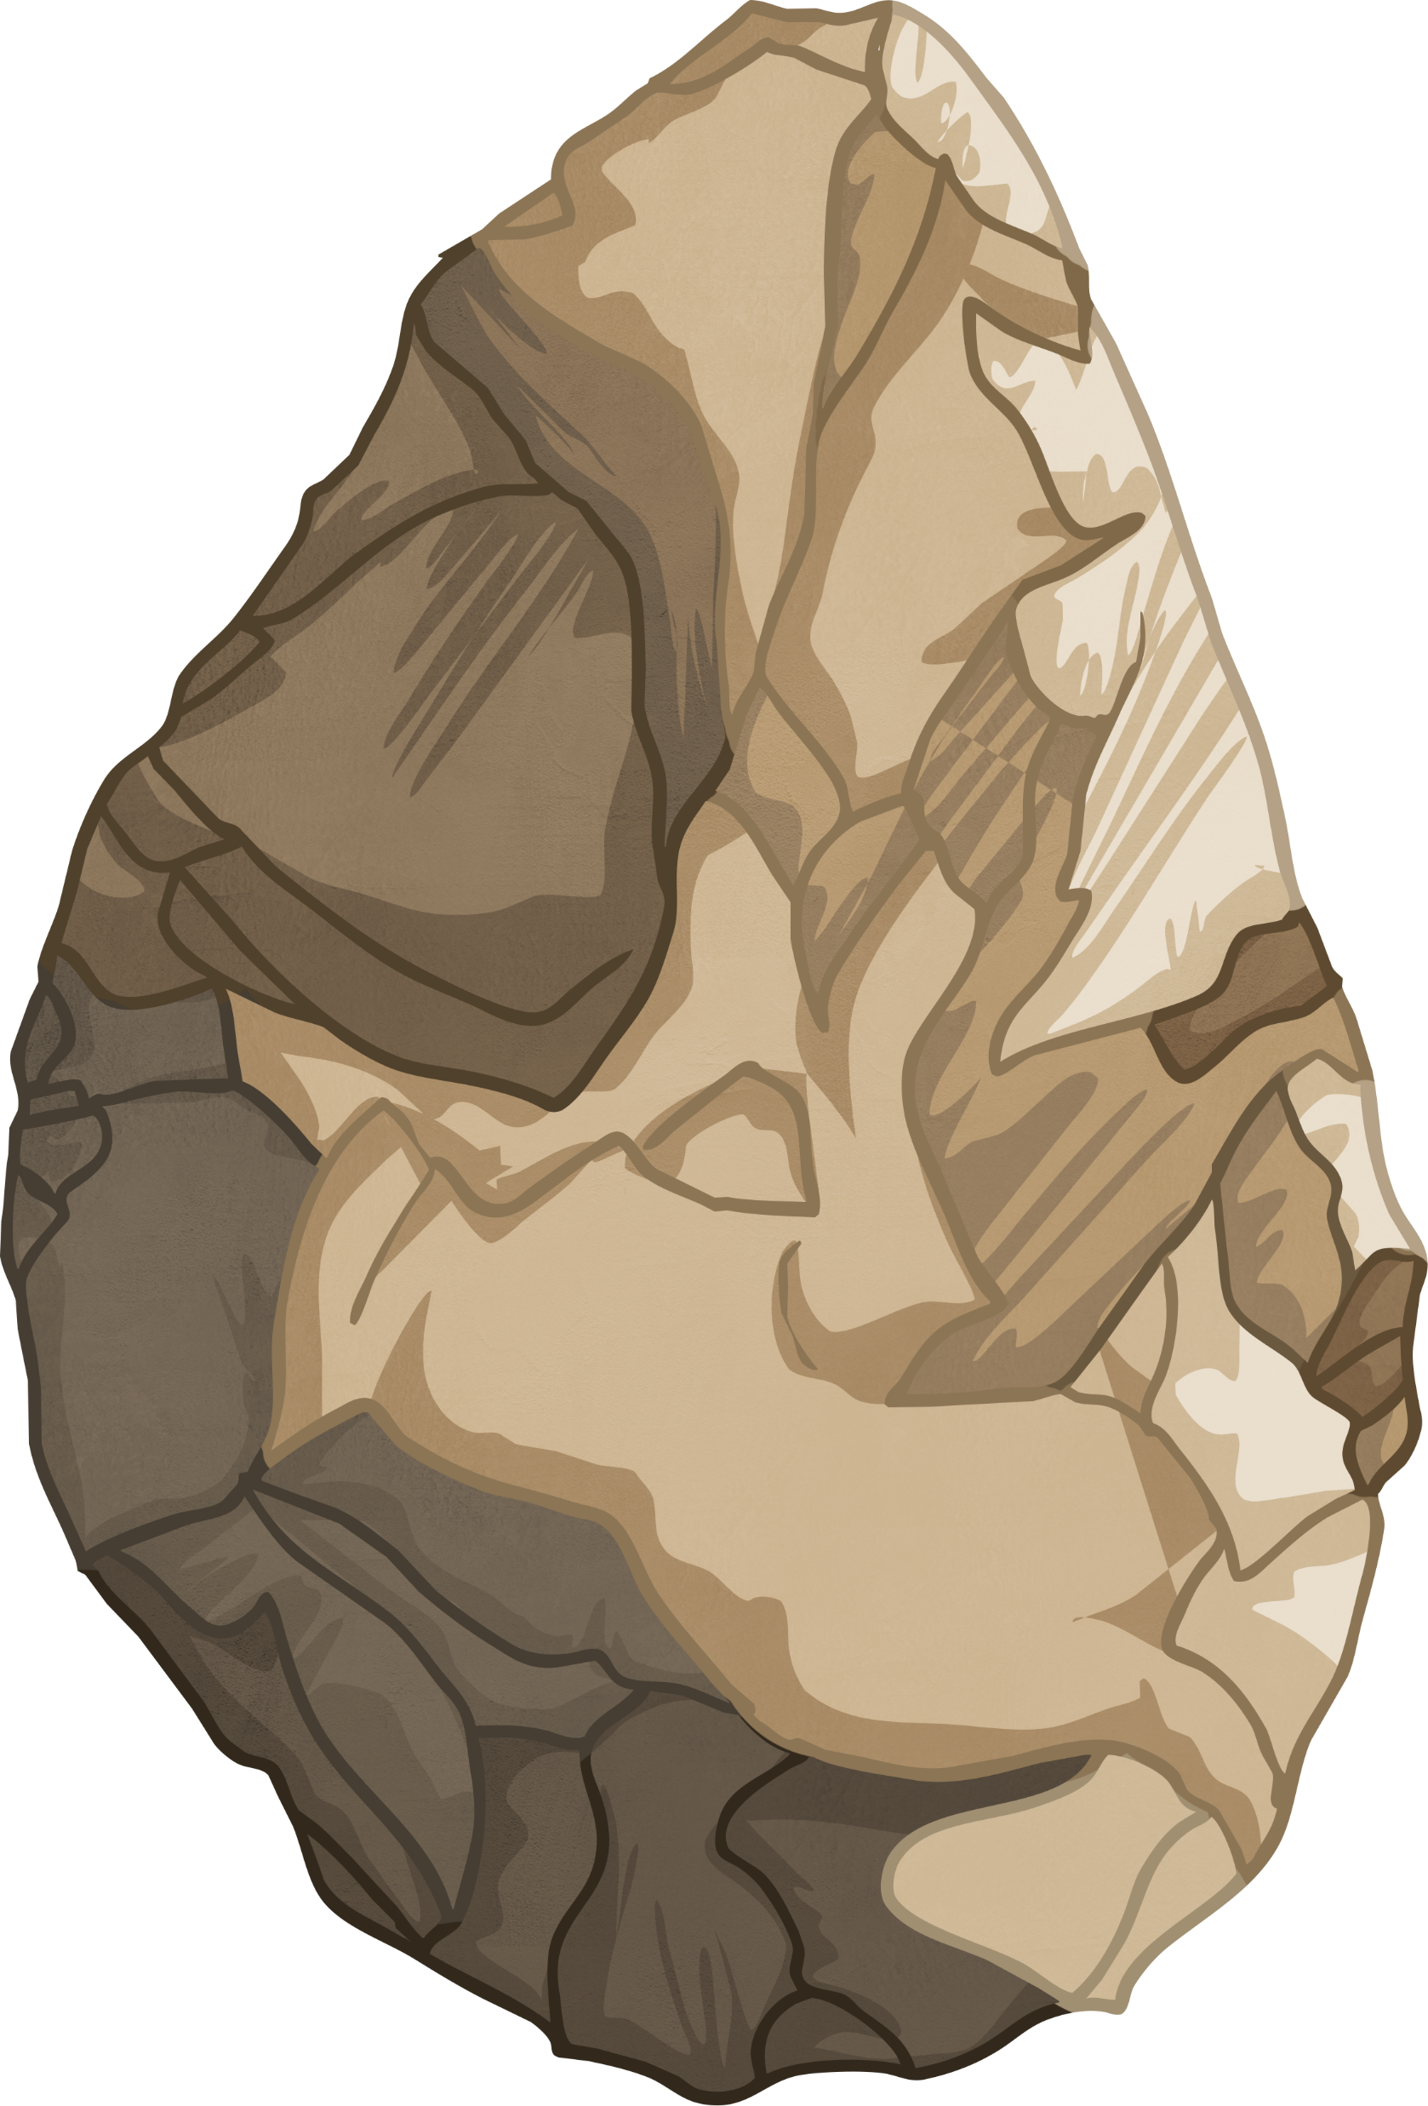
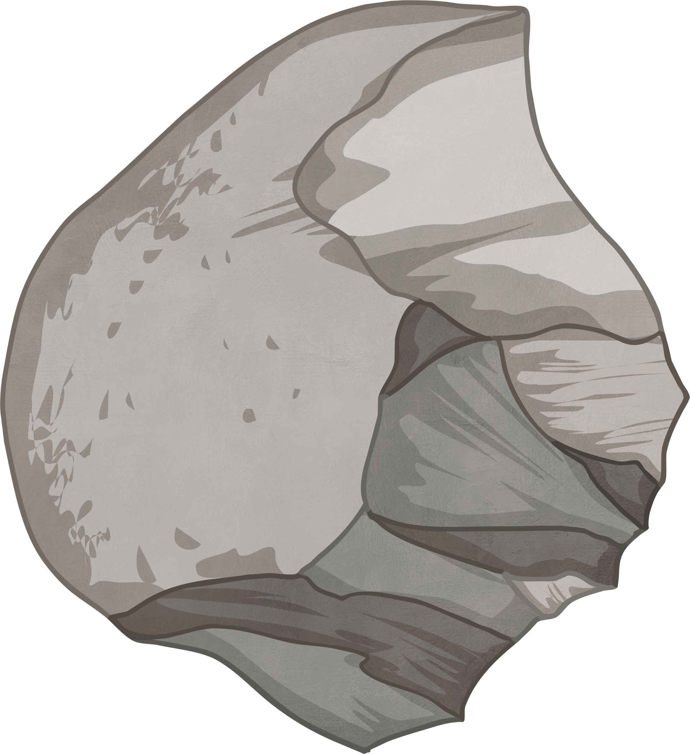
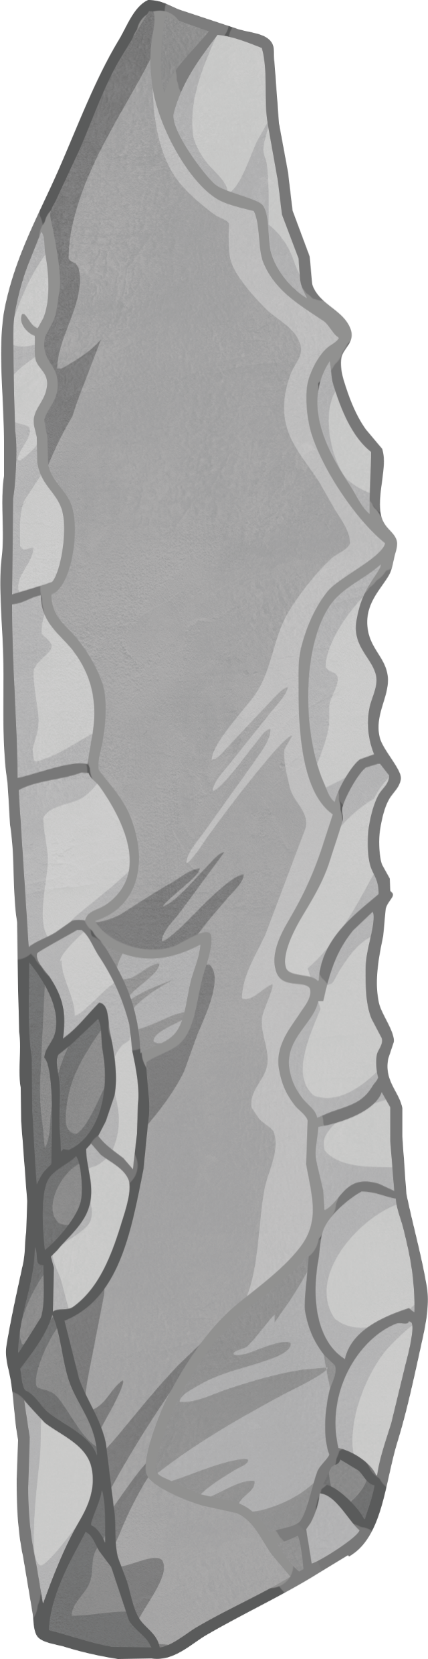
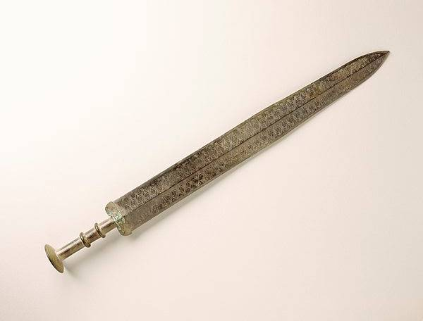
Alloys
Before the Bronze Age, tools were made of stone.
Copper was heated with tin and bronze was created!
Bronze swords have been discovered from 3000 years ago!
After this was the Iron Age.

Slide 7
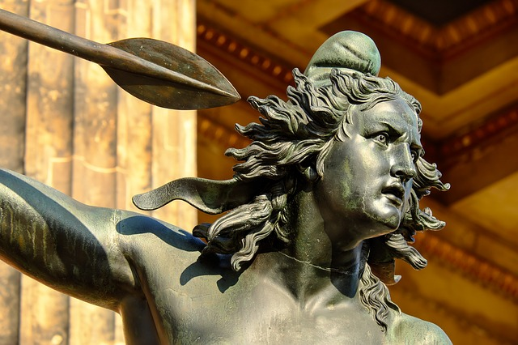


Alloys
A mixture of two or more metals, or a metal and non-metal, is called an alloy.
Bronze is made from copper and tin.
Steel is made from iron and carbon.
Take Notes
Write this definition and the
two examples in your book.
bronze statue
steel bridge

Slide 8
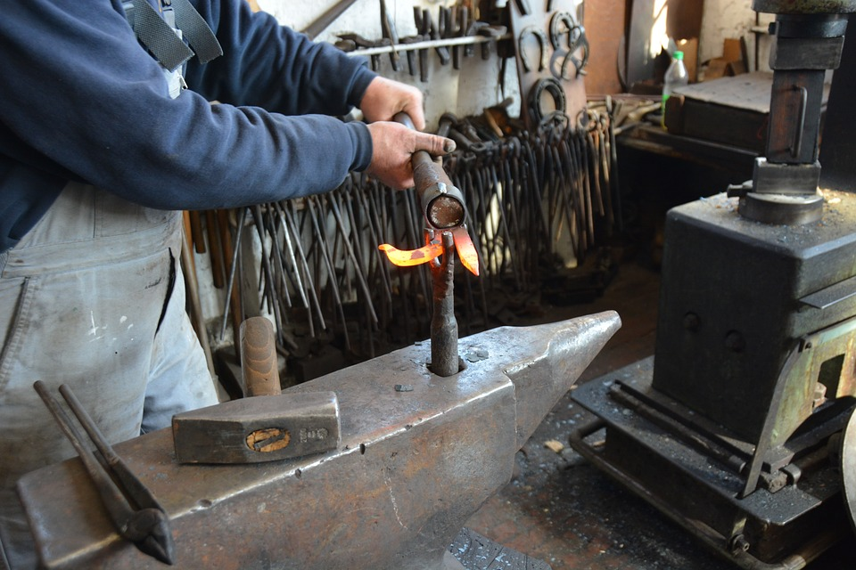
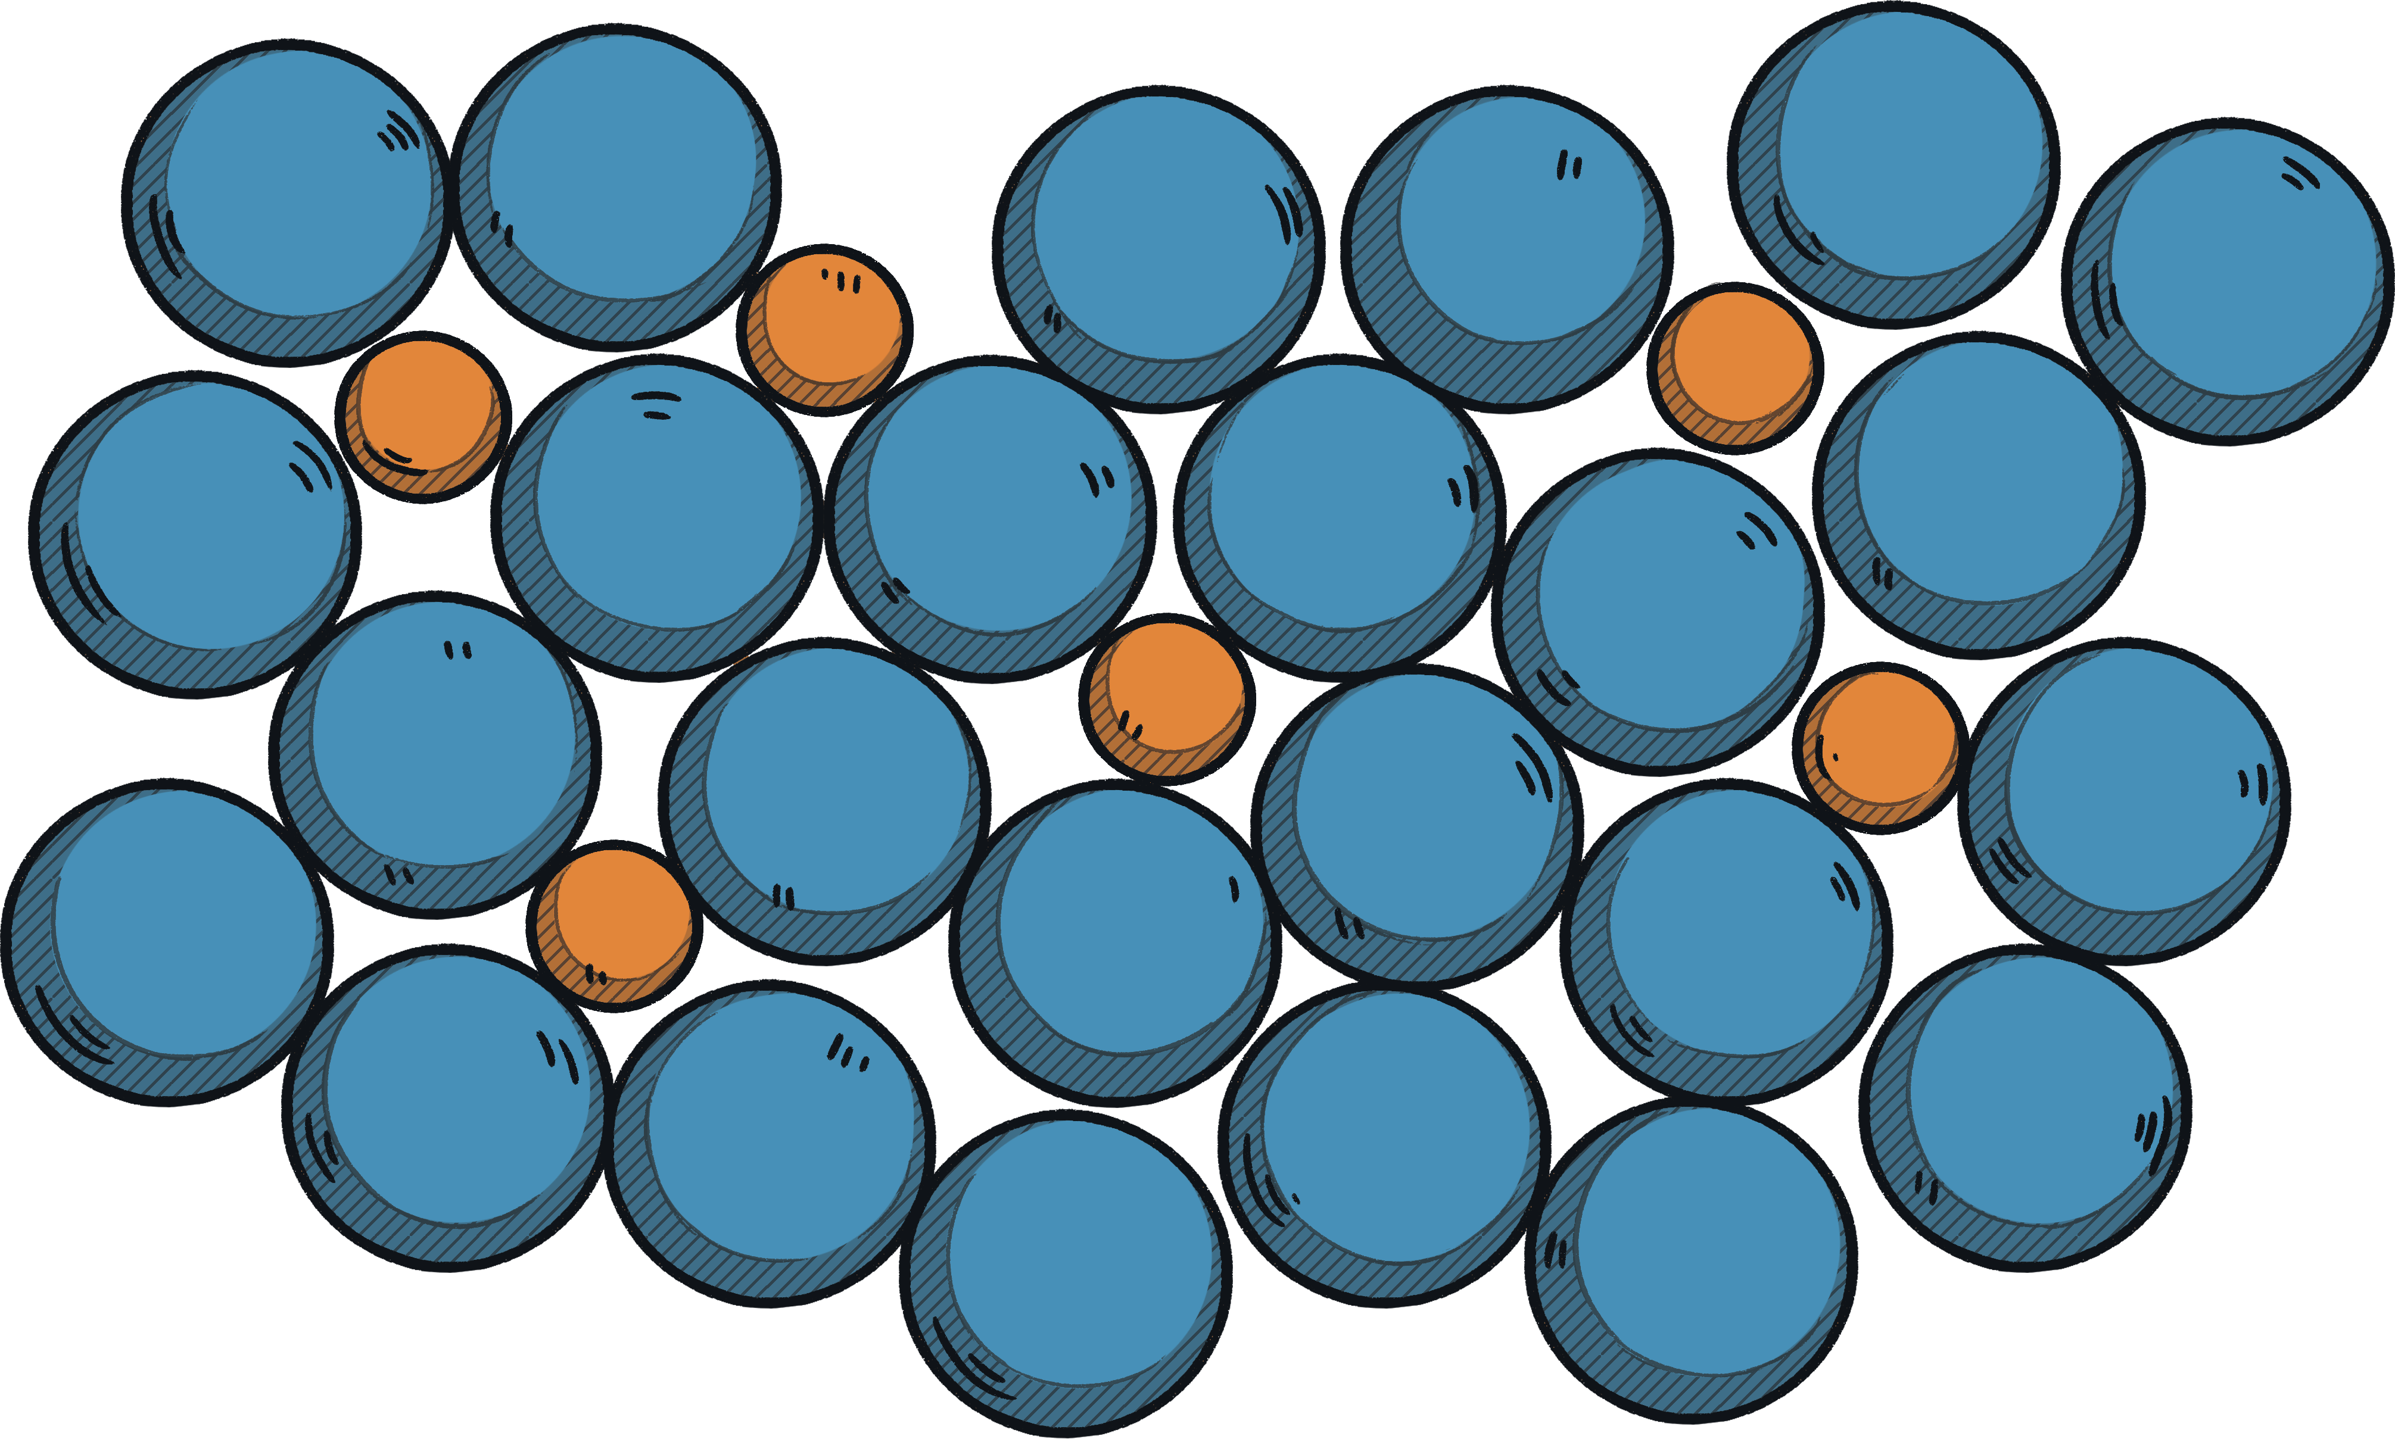
Alloys
Pure metal elements have certain properties that sometimes make them unsuitable for certain jobs.
Alloys are often stronger and harder than their individual components.

Slide 9
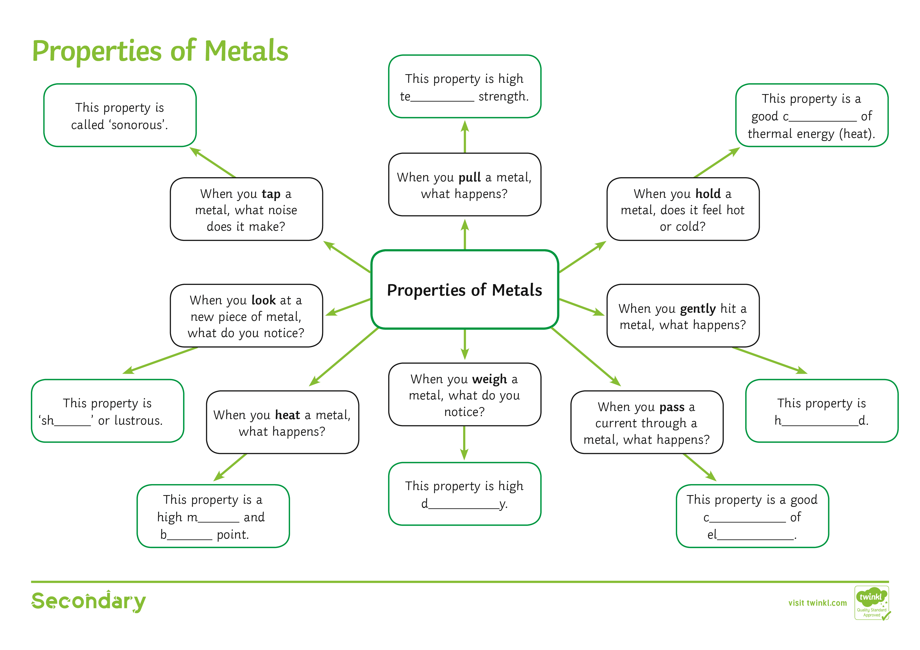

Properties of Metals Activity
Handle each metal object carefully as you complete the mind map.

Slide 10
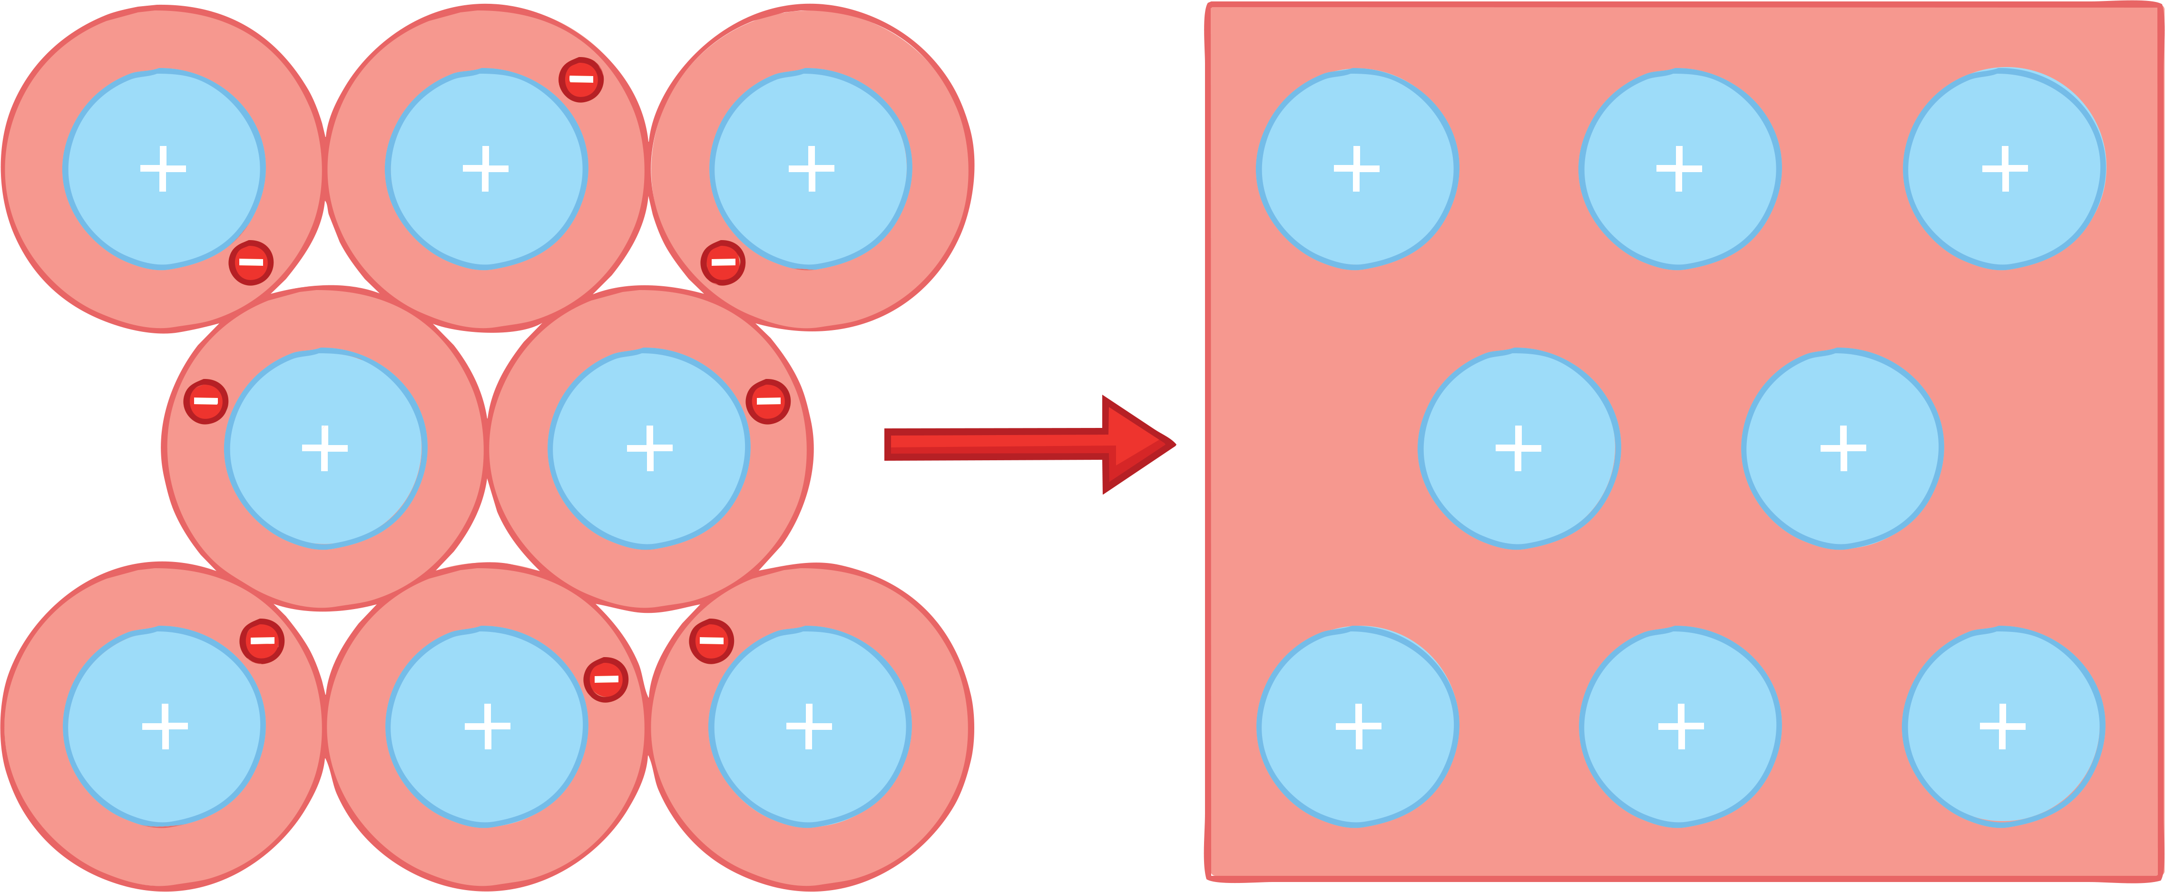
Metallic Bonding
Metallic bonding happens in metallic elements and alloys.
The electrons in the outer shell of metal atoms are delocalised so they are free to move through the structure. This leaves positive metal ions surrounded by a 'sea' of delocalised electrons.
delocalised electrons

Slide 11



Metallic Bonding
Metal ions are positively charged.
The electrons are negatively charged.
There is a strong electrostatic force of attraction between the two oppositely charged particles, which keeps the structure in place.

Slide 12
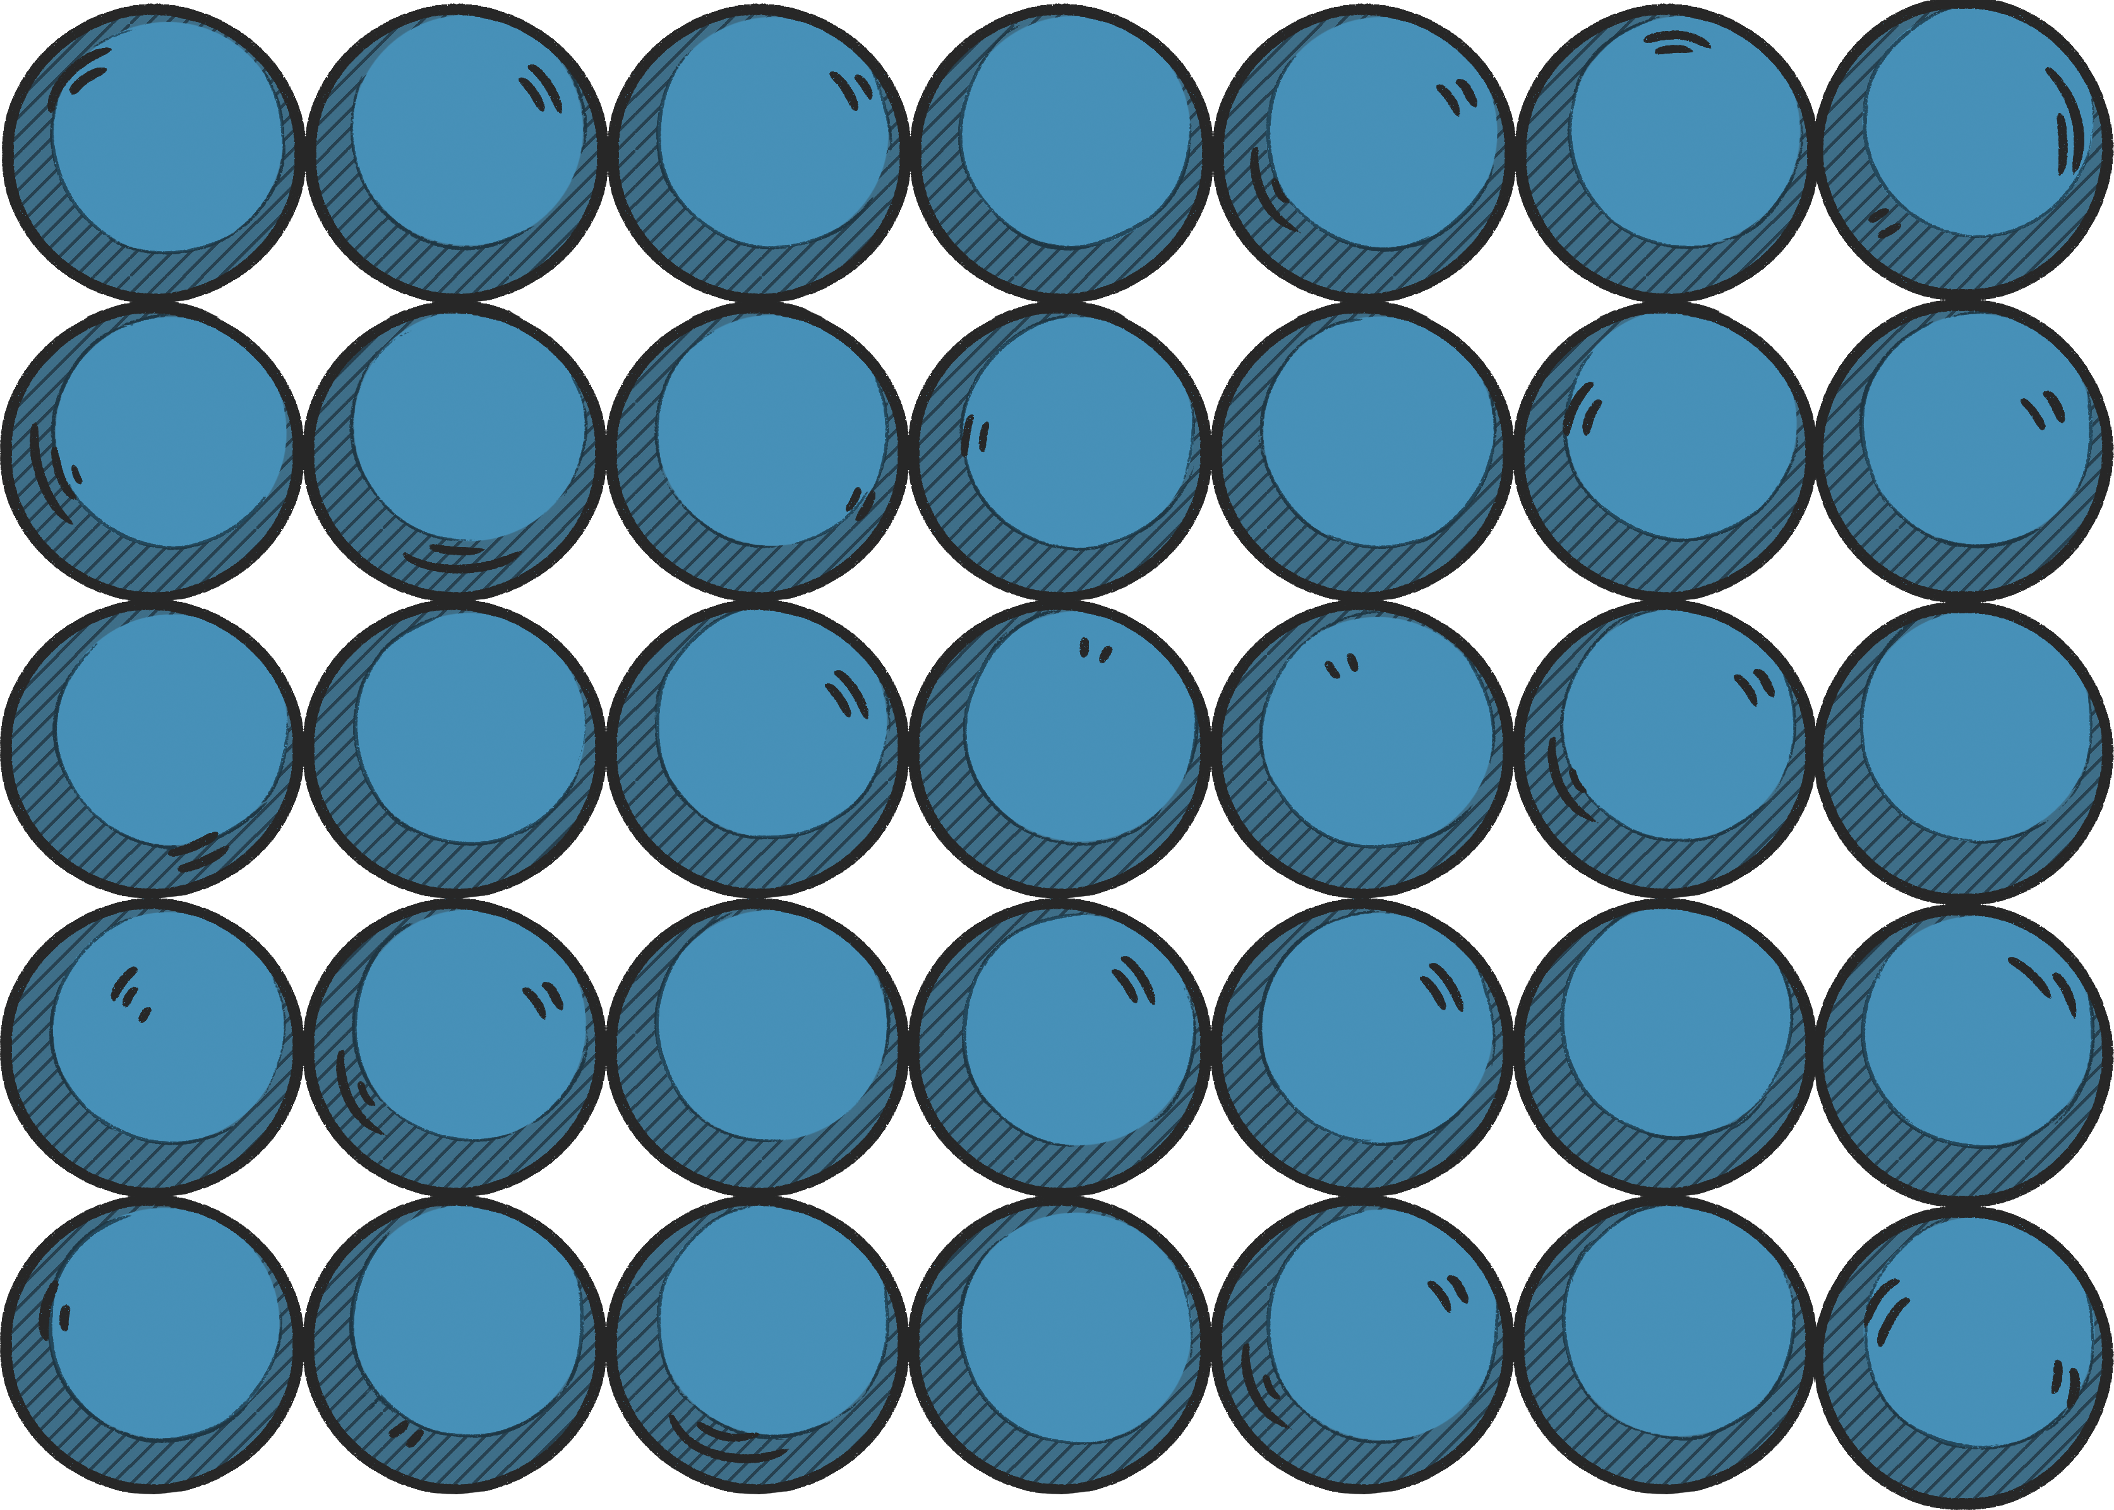
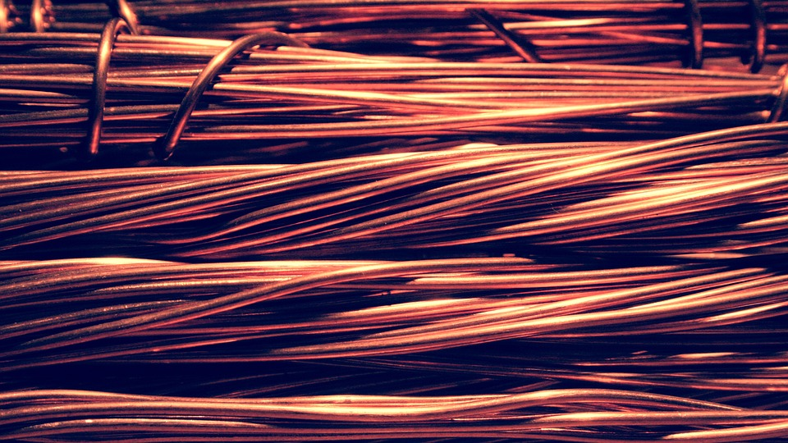
Metallic Bonding
The regular arrangement of positive and negative charges gives rise to a giant lattice structure.
However, the metal atoms are arranged in rows.
This means they can be pulled into wires. This property is called ‘ductile’.
bonding in pure metals

Slide 13
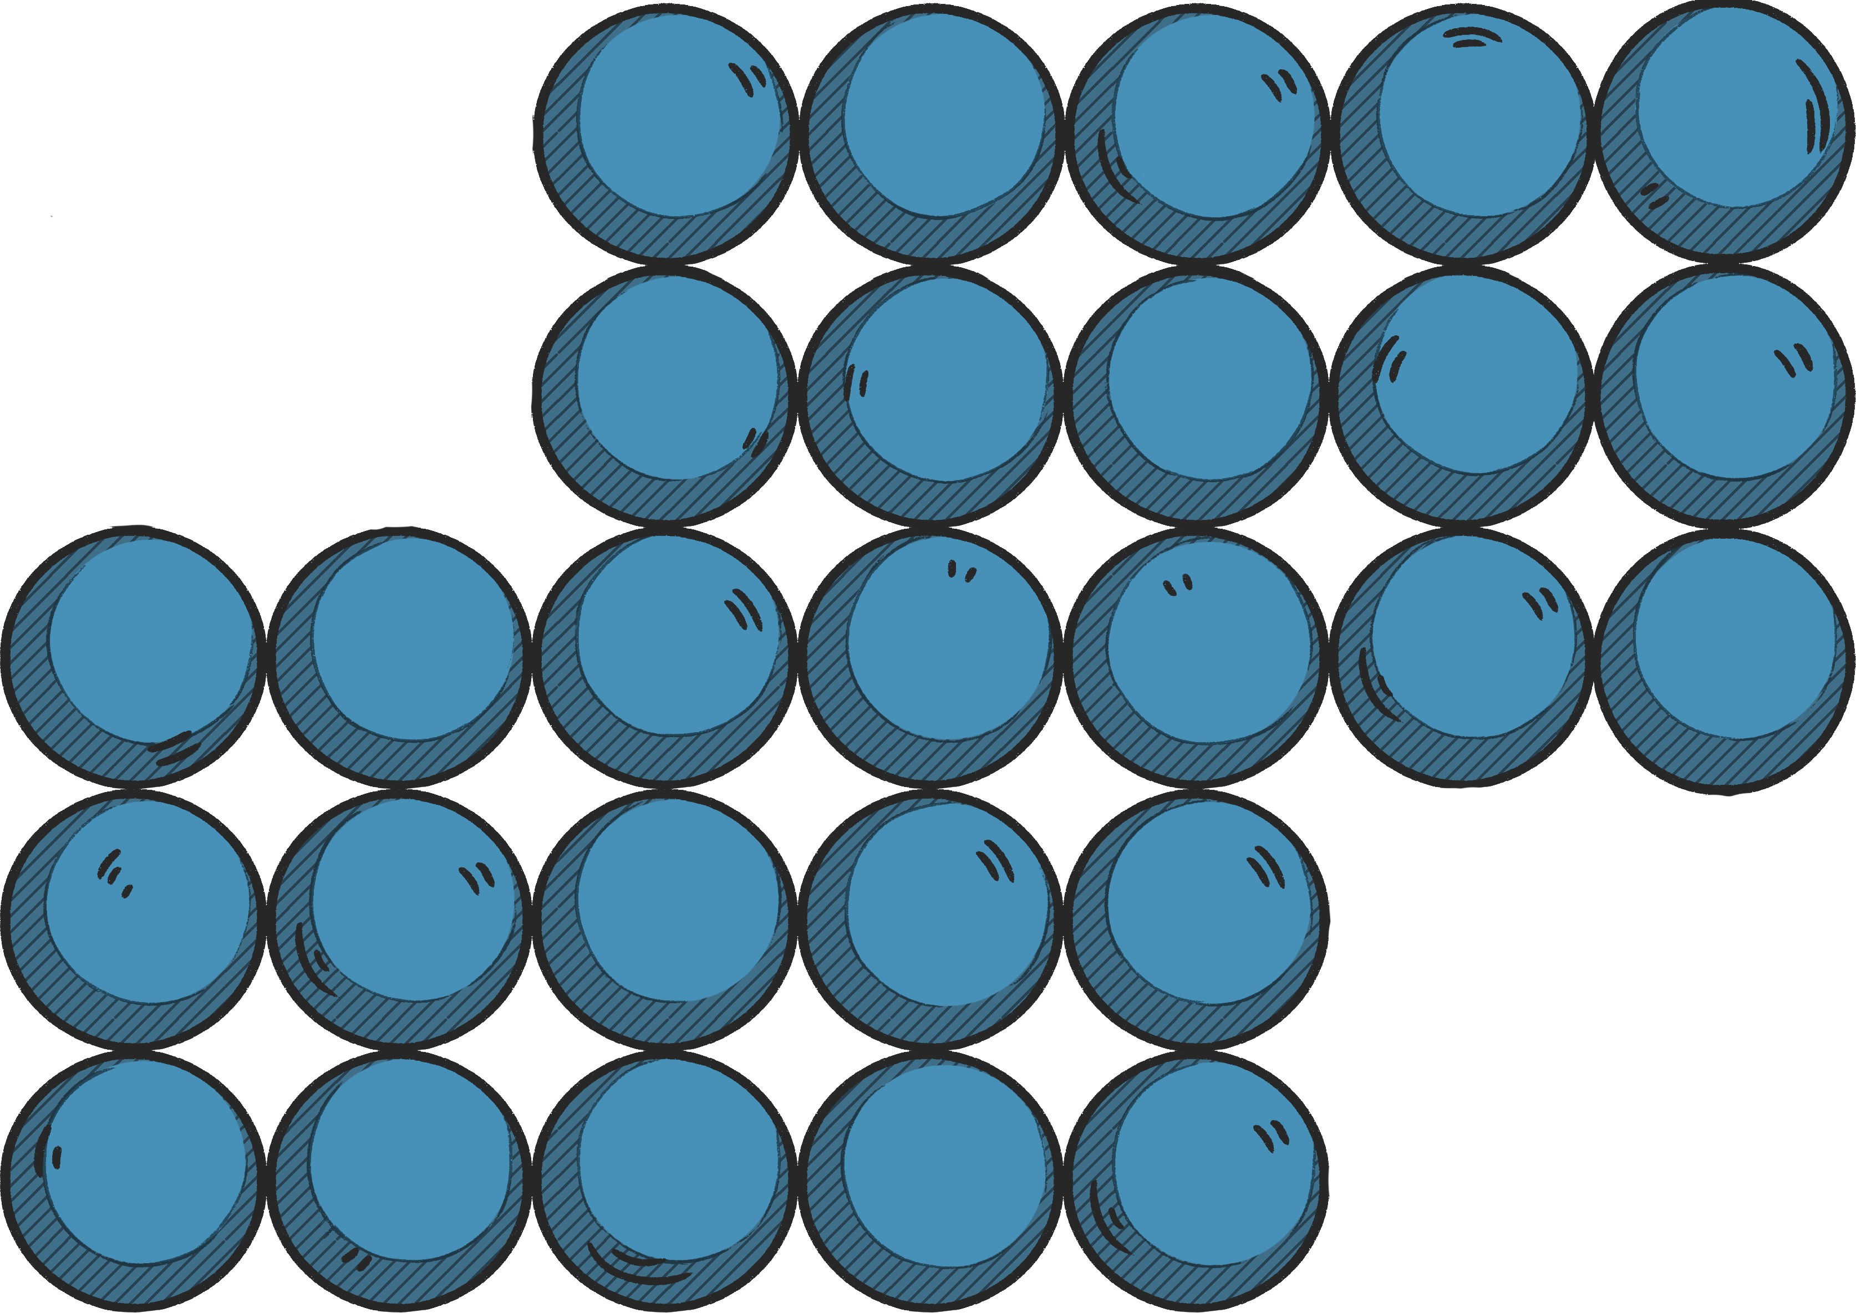
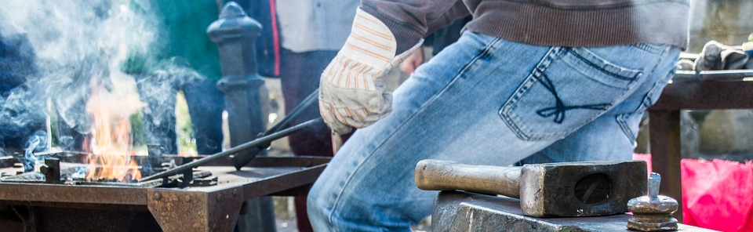
Metallic Bonding
The metal atoms being arranged in rows gives metals another unique property.
The layers can slide over one another.
This means they can be hammered into all sorts of shapes. This property is called ‘malleable’.
Atoms in pure metals can slide over each other.

Slide 14

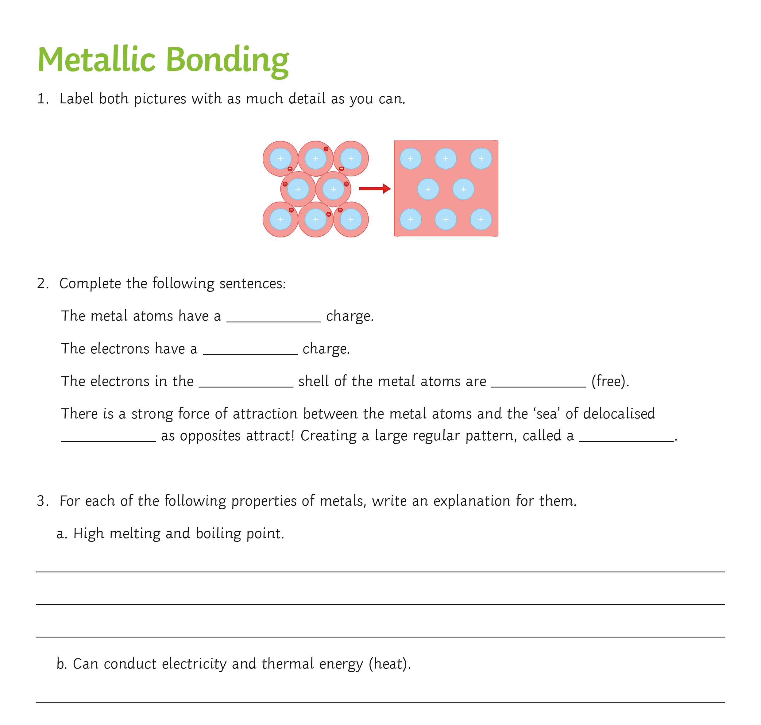
Activity Sheet
Now complete the activity sheet to demonstrate your understanding of metallic bonding so far.

Slide 15

Bonding in Alloys
Alloys are often stronger and harder than their original components.
Pause for Thought
From the pictures, can you explain why?
bonding in pure metals
bonding in alloys

Slide 16
Bonding in Alloys
The addition of atoms of another element (metal or non-metal) disrupts the regularly arranged layers.
They no longer slide over each other.
This means alloys are often stronger and harder than pure metal elements.
bonding in pure metals
bonding in alloys

Slide 17
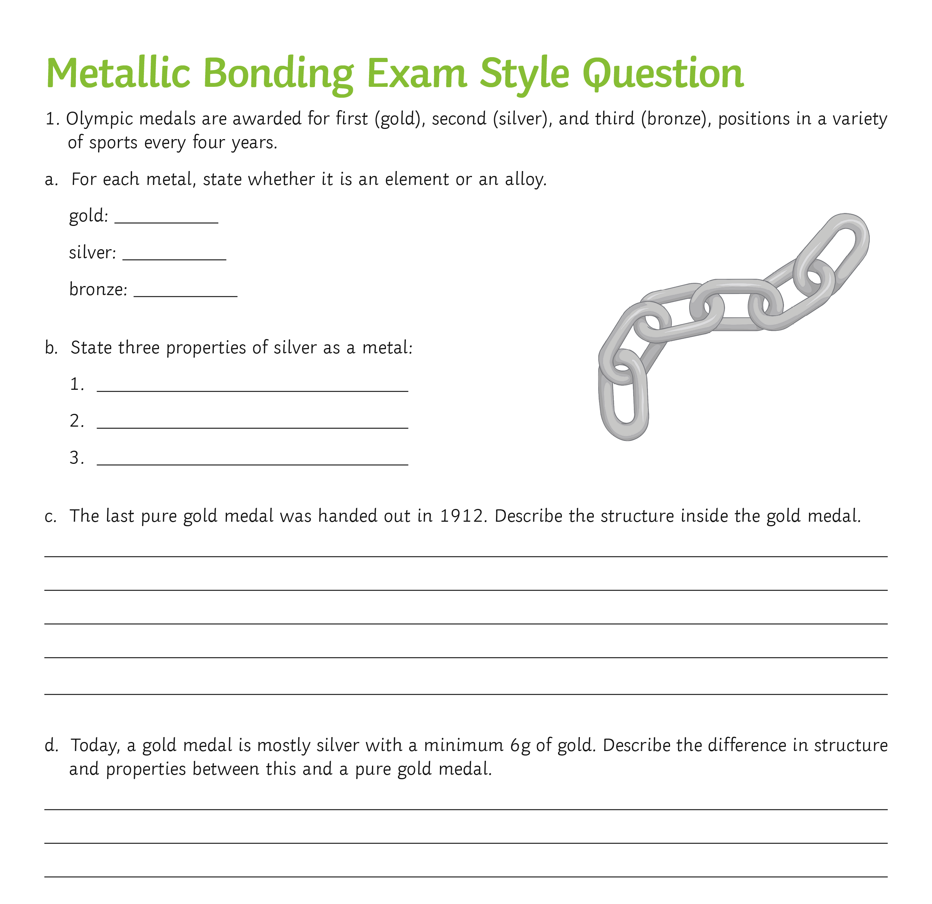
Exam Style Question
Now complete the exam style question to show your understanding of today’s lesson.

Slide 18
Plenary
Now complete the activity sheet to consolidate your knowledge of metallic, covalent and ionic bonding.

Slide 19

What Did You Achieve Today?
I can list properties of metals.
I can describe the bonding in metallic structures.
I can explain the properties of metallic structures.

